Slide 1
Marlou Pors

Slide 2
Programmable Networks
Implement your own network device using P4
Preparation: Your virtual environment
Recap on SDN
Next step: Programmable Networks
Een stap verder: Programmable Networks
Network Stacks for Dummy’s
Hands-on P4

Slide 3
Preparation: Your virtual environment
// TODO

Slide 4
Wat is Software Defined Networking?
SDN is a way of networking
Intelligence is taken from the traditional network devices and put in a separate layer
The network is being controlled by the ‘SDN controller’ or ‘Network Operating System’
We call it ‘software defined’ because you can add self-written application to the controller, implementing the functionality of the network.

Slide 5
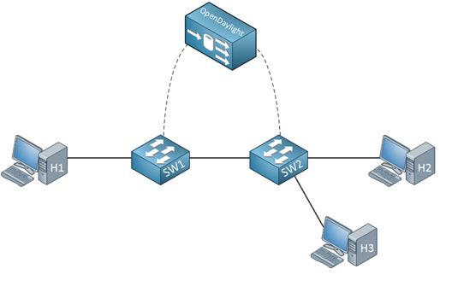
SDN Components
Controller:
Network configuration is added statically or dynamically
Control Channel:
Traffic towards the network devices can rely on different protocols
Netwerk Device:
Contain different tables to match packets to actions.

Slide 6
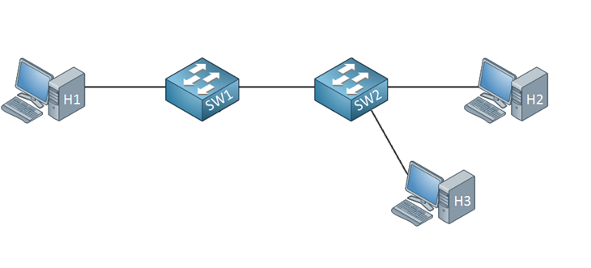
Focus on the switch
Adding entries to the tables such that actions can be performed
Definition of tables and actions

Slide 7

Focus on the switch
Adding entries to the tables such that actions can be performed

Slide 8

Communication in its simplest form (1)
Recieved at port 1, send out to port 2
Received at port 2, send out to port 1
In all other cases, do nothing
1
2
Key (inport) | Action (set outport or do nothing) | Action parameters

Slide 9
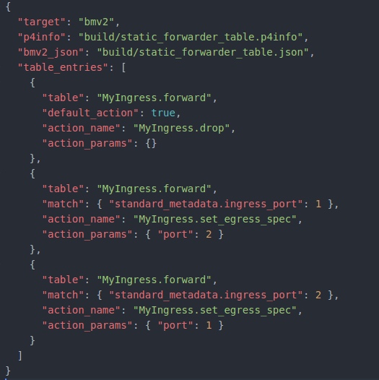
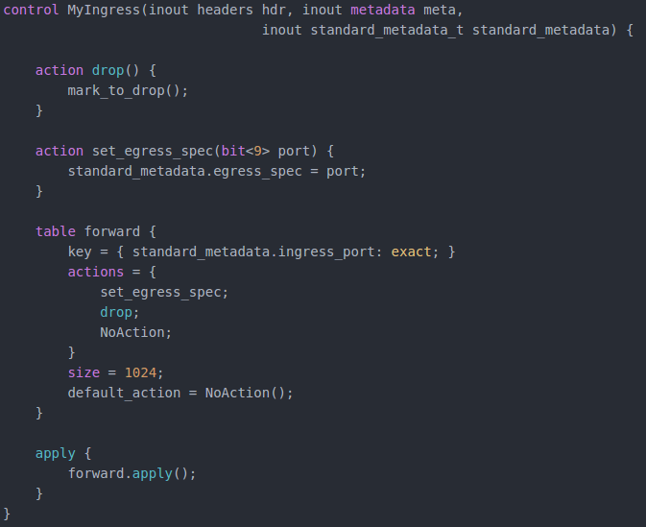
Adding table entries
Definition of tables and actions

Slide 10

Communication in its simplest form (2)
1
2
Key (inport) | Action (set outport or do nothing) | Action parameters
1 | set_egress_spec | 2
2 | set_egress_spec | 1
* | drop | -

Slide 11
Hands-on P4!
// TODO

Slide 12

Hail Caesar!

Slide 13
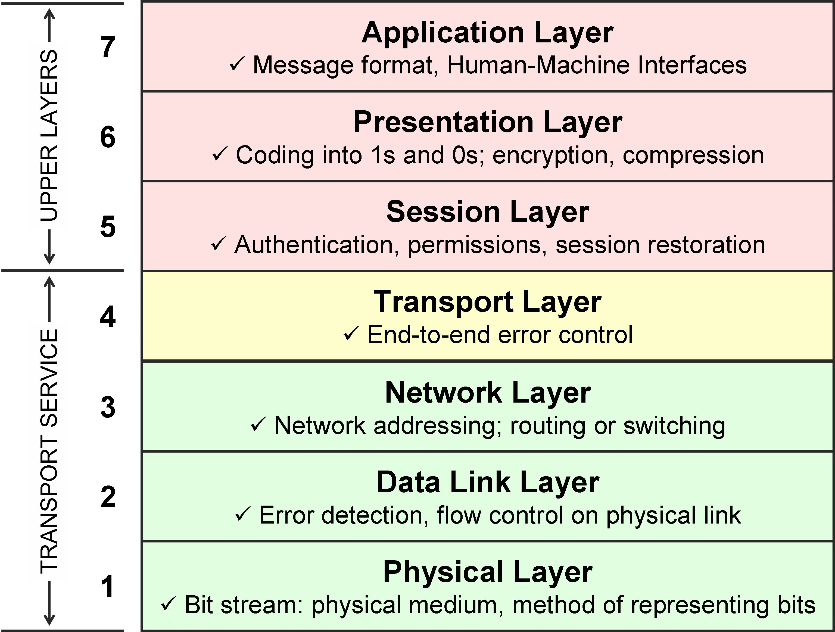
All Programmers Seem To Need Dominos Pizza

Slide 14
All Programmers Seem To Need Dominos Pizza

Slide 15
Using the Networking Stack (1)
“Hello!”
1
2

Slide 16
Using the Networking Stack (2)
“Hello!”
IP address: 10.0.1.2
MAC address: 00:00:00:00:00:02
1
2
IP address: 10.0.1.1
MAC address: 00:00:00:00:00:01
MAC Header (Data Link Layer) |  | IP Header (Network Layer) |  | DATA
From 00:00:00:00:00:01 | To 00:00:00:00:00:02 | From 10.0.1.1 | To 10.0.1.2 | “Hello”
Here we find headers of the other network layers

Slide 17
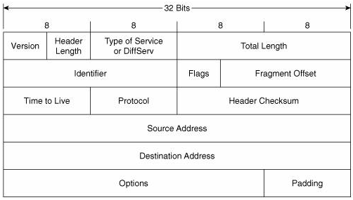
“Would that it were so simple”
One can dissect complete packets and their headers using WIRESHARK
MAC Header (Data Link Layer) |  | IP Header (Network Layer) |  | DATA
From 00:00:00:00:00:01 | To 00:00:00:00:00:02 | From 10.0.1.1 | To 10.0.1.2 | “Hello”

Slide 18
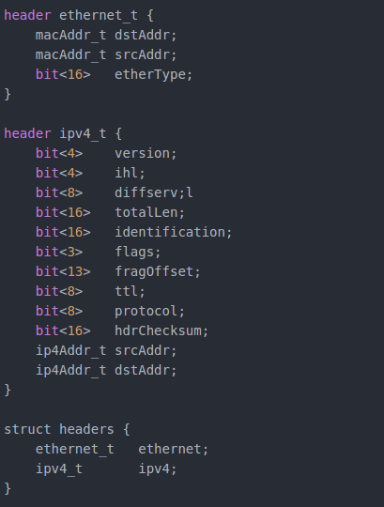
Header definition in P4
MAC Header (Data Link Layer) |  | IP Header (Network Layer) |  | DATA
From 00:00:00:00:00:01 | To 00:00:00:00:00:02 | From 10.0.1.1 | To 10.0.1.2 | “Hello”

Slide 19
Using the Networking Stack (3)
What a Switch will do is:
“Parse” the headers starting at the outmost header
Depending on the header content, a particular next step follows
Some part of the header information is stored in so-called ‘metadata’
For example: in_port en out_port
Header information gets an update if needed
Values as the ‘time-to-live’
The packet is constructed in the correct order and send out

Slide 20
Programmable switches in a SDN (1)
Adding table entries manually
vs.
Let a SDN controller fill the tables

Slide 21
Programmable switches in a SDN (2)
Controller:
Simple Python / JAVA scripts
ONOS
….
Control Channel:
P4 Runtime

Slide 22
A simple SDN using P4 and P4 Runtime!
// TODO

